Slide 1
The MegaDerm 3000
Team 9
Kristen Hagan
Mahy Hussain
Laura Kenyon
Thomas Leahy

Slide 2
Process Overview

Slide 3
Process Overview
Perform single-image Analysis on every image
Prompt user to crop the ruler and mole
Detect the
lesion border
Perform time-lapse analysis for individual data collected from every image
Border Contour Map
Change in area over time
Change in asymmetry over time
Change in color variation over time
Find the pixel/mm conversion factor
Calculate lesion
area
Prompt user to input image stack
Calculate asymmetry coefficients
Calculate Color
Variation Coefficients

Slide 4
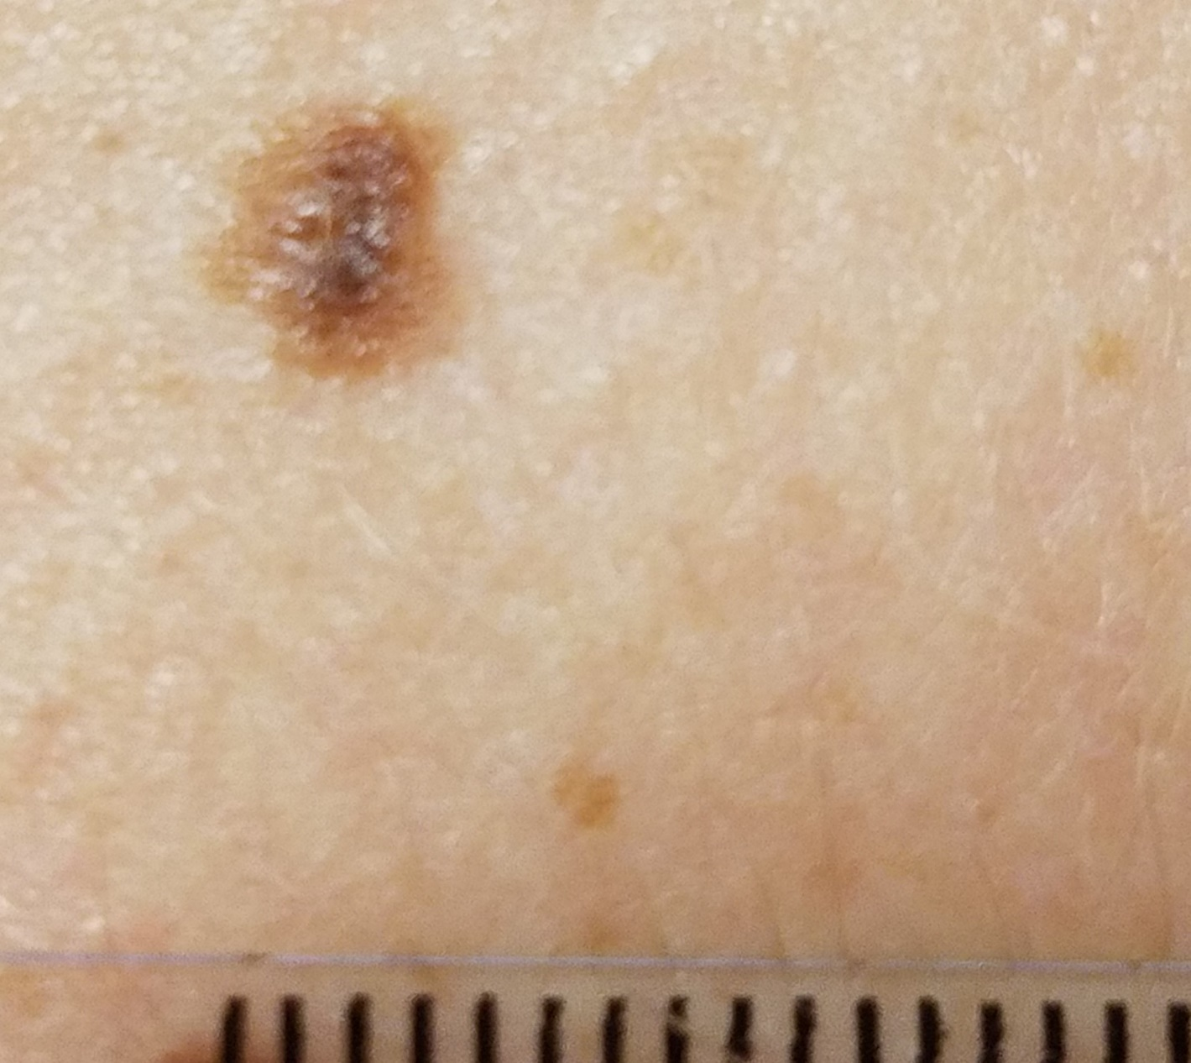
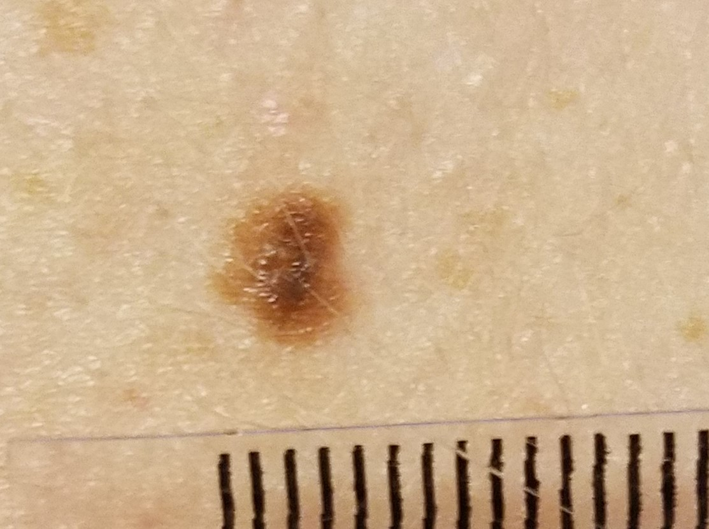
Input Image Stack
Images requires lesion and millimeter ruler at same focal length for pixel-mm conversion factor calculation

Slide 5

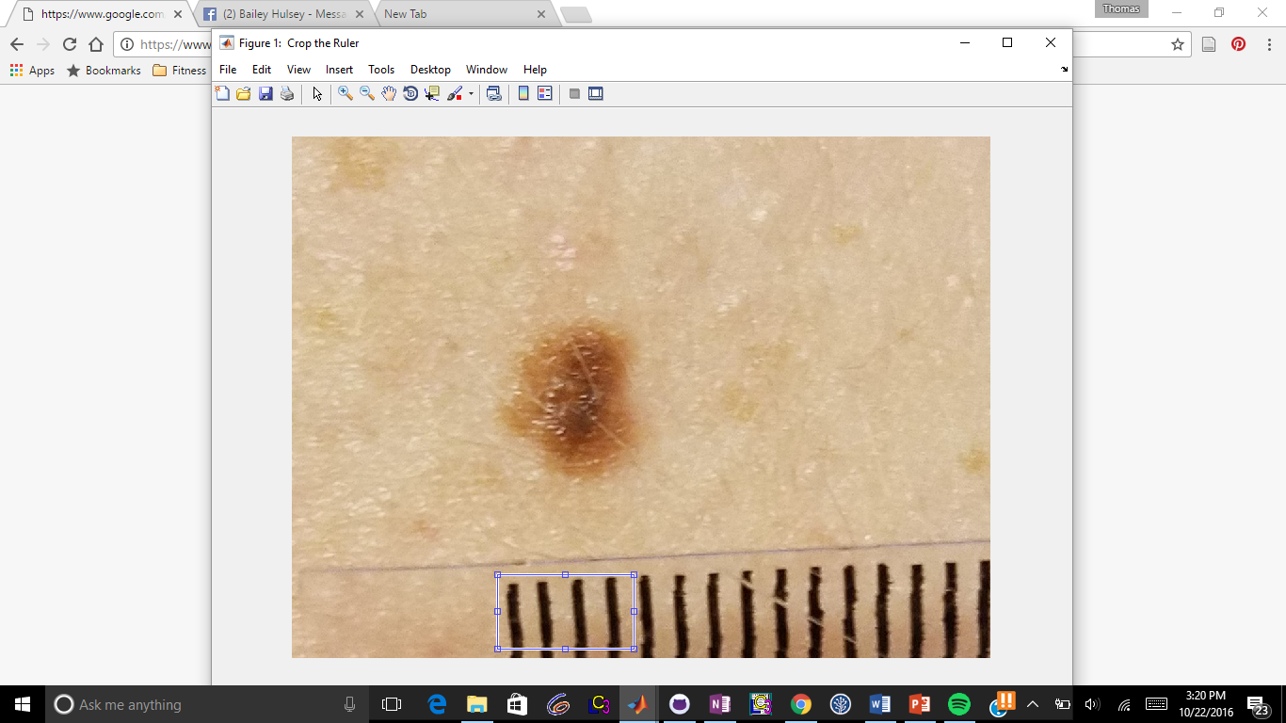
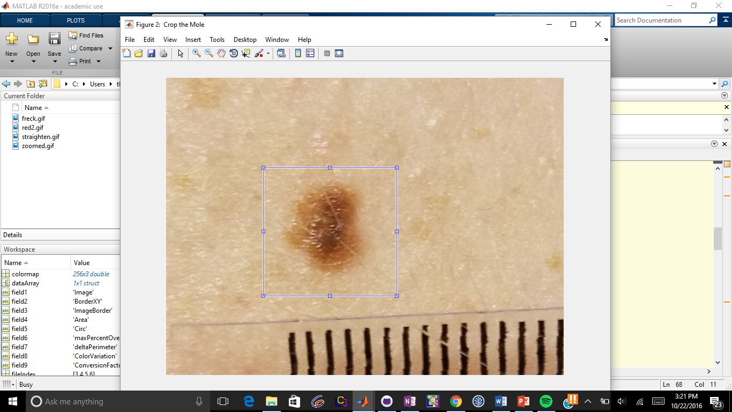
User Input - Cropping
Ruler Crop
Mole Crop

Slide 6
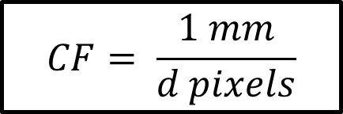
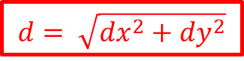
Finding the mm/pixel conversion factor (CF)
$$d= \sqrt{{dx}^{2}+{dy}^{2}}$$
dy
dx
$$CF= \frac{1 mm}{d pixels}$$
Notes:
$$d= \sqrt{{dx}^{2}+{dy}^{2}}$$
$$d= \sqrt{{dx}^{2}+{dy}^{2}}$$
$$CF= \frac{1 mm}{d pixels}$$

Slide 7
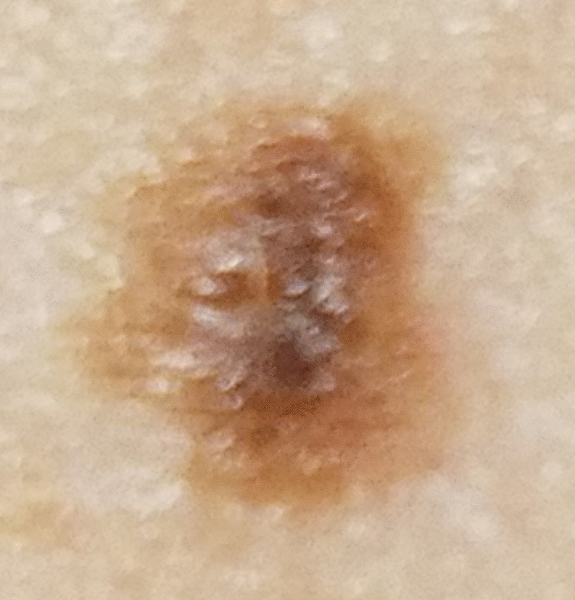
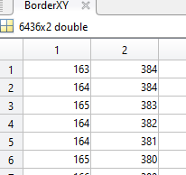
Detecting the lesion border
XY Coordinates for the Border
Binarized Image

Slide 8
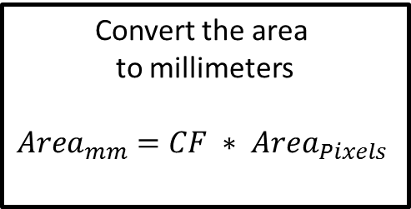
Calculate the lesion area
Binarized Image
Sum the number of pixels considered part of the mole
Convert the area to millimeters
$${Area}_{mm}=CF ∗ {Area}_{Pixels}$$

Slide 9
Calculate the lesion area

Slide 10
Results

